Slide 1
APPROACHES TO WRITING

Slide 2
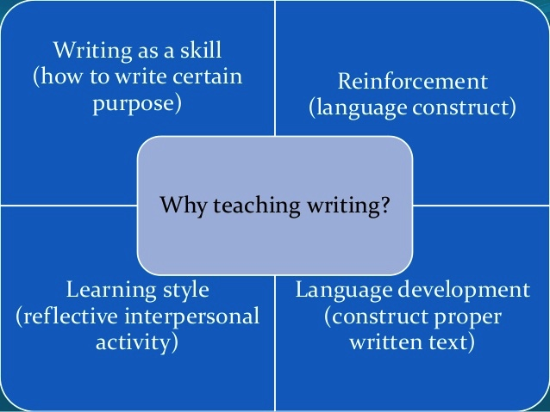
REASONS OF TEACHING WRITING

Slide 3
TEACHING WRITING SKILLS
Literacy
Handwriting
Spelling
Layout and punctuation

Slide 4
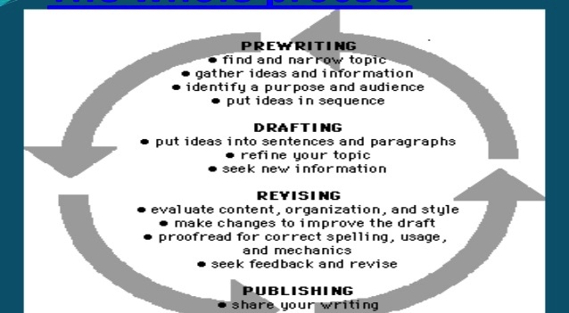
STAGES OF WRITING

Slide 5
THE ROLE OF THE TEACHER
Motivator
Resource
Feedback provider

Slide 6
MAIN APPROACHES TO WRITING
A PROCESS APPROACH
A SOCIAL-CONSTRUCTIONIST APPROACH
A PRODUCT APPROACH

Slide 7
PRODUCT APPROACH
treating the text as a complete, finished product
starting with a MODEL test presented as a reading comprehension
analyzing the organization and language of the model
making generalization and rules
producing a piece of writing which closely mirrors the model text

Slide 8
PROCESS APPROACH
Before writing (planning and drafting)
While writing and after (proofreading and editing )
final version (not always a complete text)
Treats writing as a process happening in a series of stages

Slide 9
SOCIAL-CONSTRUCTIONIST APPROACH
Emphasizes the social aspects of writing
Target reader
Writer’s purpose
Communicate information
Create right impression

Slide 10
CONCLUSIONS
Teaching writing is not a simple way in the process where as a teacher we have to consider such things as: handwriting, spelling, layout and communication
Some approaches to be known in writing can be listed as following:
process and product, genre, creative writing, building special writing habit and writing as a cooperative activity

